Slide 1
MA3077 (DLI) Operational Research Lecture 9 – Integer modelling
Dr Neslihan Suzen

Slide 2
Recap and lecture outline
Summary: we have learnt:
how to model some mixed-integer linear programming problems,
how to solve them in Matlab using intlinprog,
what the branch and bound technique is,
and that some mixed-integer problems have a so-called integer solution property.
Today: More modelling using integer variables, following closely chapter 9.1 of the Mosek Cookbook.

Slide 3
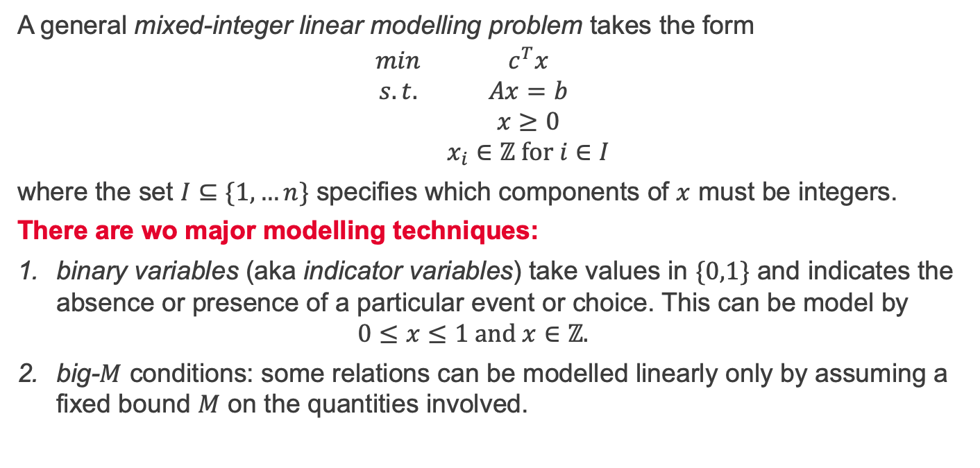
Mixed-integer linear modelling
A general mixed-integer linear modelling problem takes the form
$$\begin{matrix}min & c^{T}x \\ s.t. & Ax=b \\ & x≥0 \\ & x_{i}∈ℤ for i∈I\end{matrix}$$
where the set $I⊆\{1,…n\}$ specifies which components of $x$ must be integers.
There are wo major modelling techniques:
binary variables (aka indicator variables) take values in $\{0,1\}$ and indicates the absence or presence of a particular event or choice. This can be model by $0≤x≤1 and x∈ℤ.$
big-$M$ conditions: some relations can be modelled linearly only by assuming a fixed bound $M$ on the quantities involved.

Slide 4
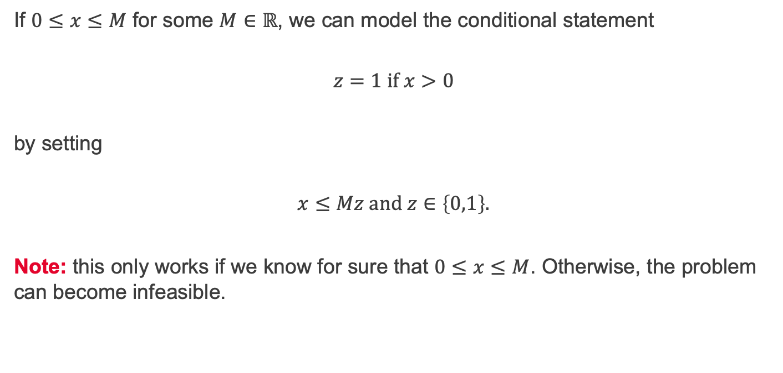
Implication of positivity
If $0≤x≤M$ for some $M∈ℝ$, we can model the conditional statement
$$z=1 if x>0$$
by setting
$$x≤Mz and z∈\left\{0,1\right\}.$$
Note: this only works if we know for sure that $0≤x≤M$. Otherwise, the problem can become infeasible.

Slide 5
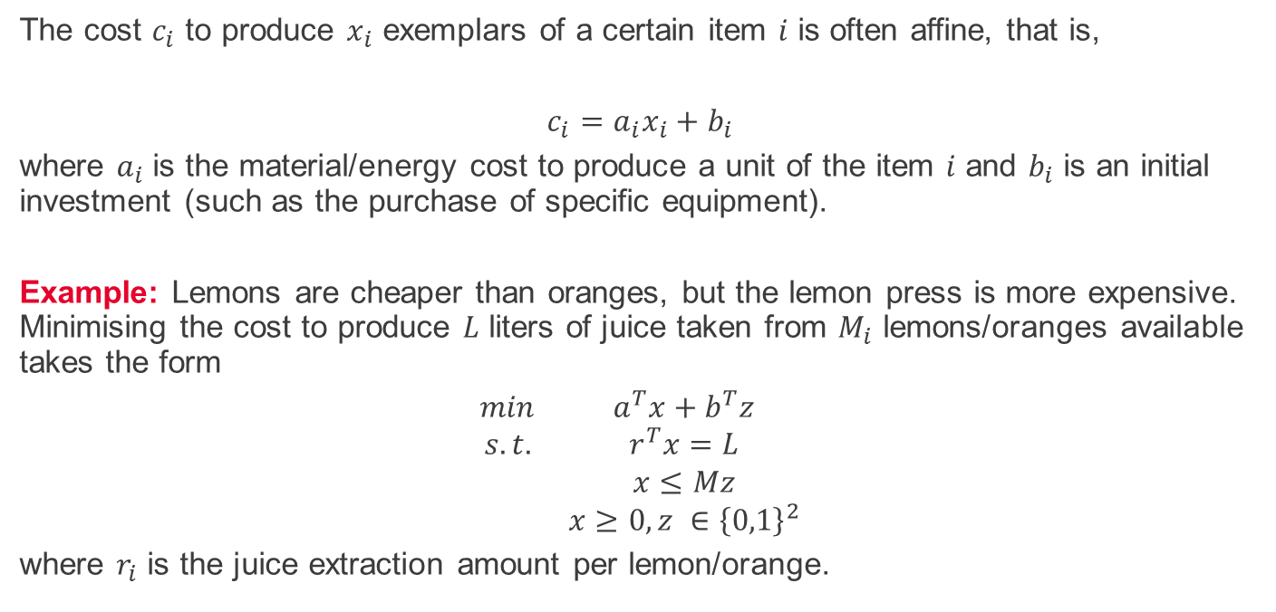
Implication of positivity - example
The cost $c_{i}$ to produce $x_{i}$ exemplars of a certain item $i$ is often affine, that is,
$$c_{i}=a_{i}x_{i}+b_{i}$$
where $a_{i}$ is the material/energy cost to produce a unit of the item $i$ and $b_{i}$ is an initial investment (such as the purchase of specific equipment).
Example: Lemons are cheaper than oranges, but the lemon press is more expensive. Minimising the cost to produce $L$ liters of juice taken from $M_{i}$ lemons/oranges available takes the form
$$\begin{matrix}min & a^{T}x+b^{T}z \\ s.t. & r^{T}x=L \\ & x≤Mz \\ & x≥0, z ∈{\left\{0,1\right\}}^{2}\end{matrix}$$
where $r_{i}$ is the juice extraction amount per lemon/orange.

Slide 6
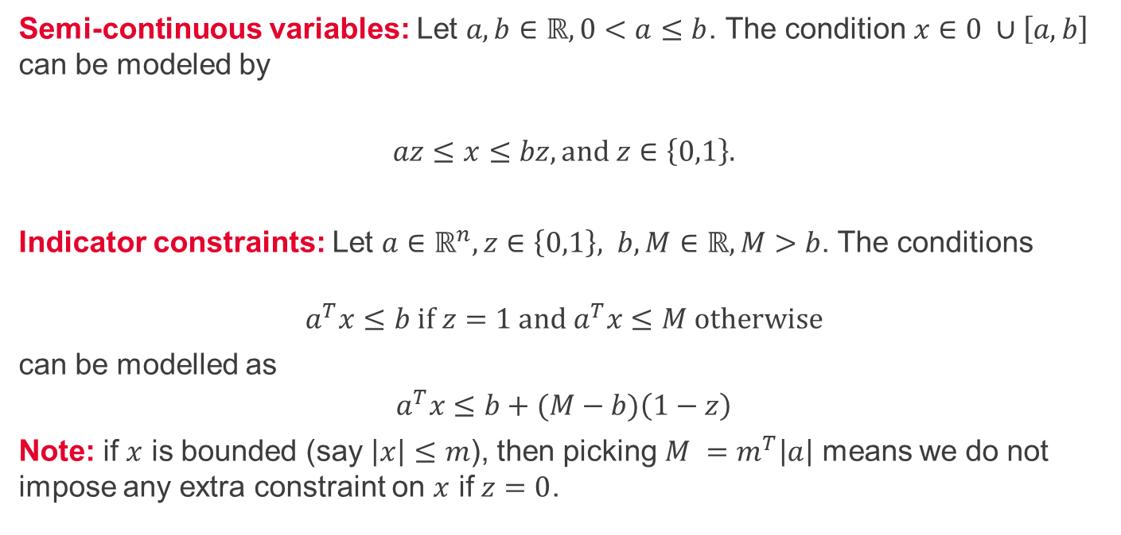
Semi-continuous variable, indicator constraints
Semi-continuous variables: Let $a,b∈ℝ, 0<a≤b$. The condition$x∈0 ∪\left[a,b\right]$ can be modeled by
$$az≤x≤bz, and z∈\left\{0,1\right\}.$$
Indicator constraints: Let $a∈ℝ^{n},z∈\left\{0,1\right\}, b,M∈ℝ, M>b$. The conditions
$$a^{T}x≤b if z=1 and a^{T}x≤M otherwise$$
can be modelled as
$$a^{T}x≤b+(M−b)\left(1−z\right)$$
Note: if $x$ is bounded (say $\left|x\right|≤m$), then picking $M =m^{T}\left|a\right|$ means we do not impose any extra constraint on $x$ if $z=0$.

Slide 7
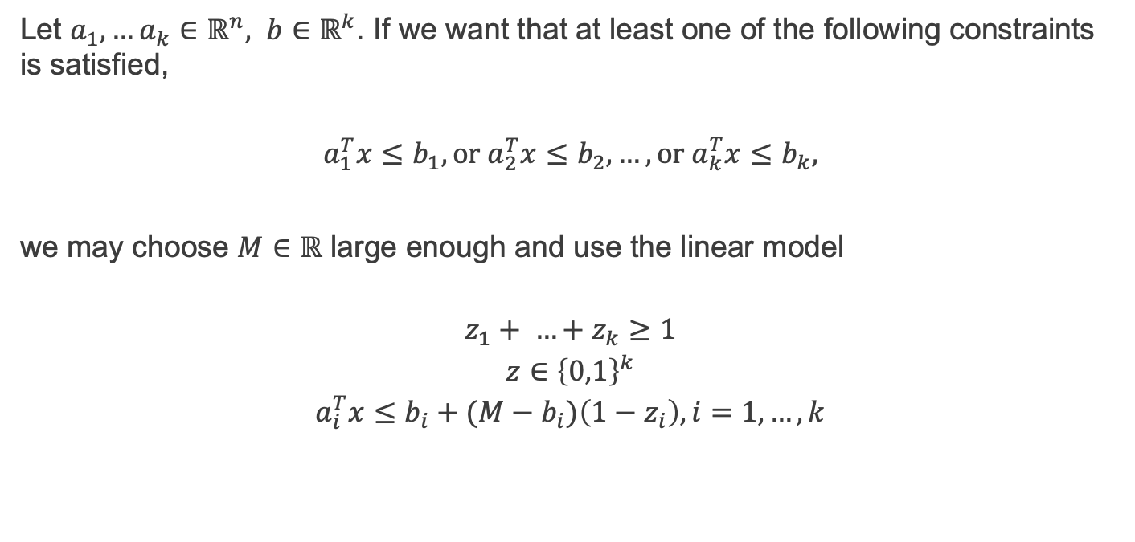
Disjunctive constraints
Let $a_{1},…a_{k}∈ℝ^{n}, b∈ℝ^{k}$. If we want that at least one of the following constraints is satisfied,
$$a_{1}^{T}x≤b_{1},or a_{2}^{T}x≤b_{2}, …, or a_{k}^{T}x≤b_{k},$$
we may choose $M∈ℝ$ large enough and use the linear model
$$\begin{matrix}z_{1}+ …+z_{k}≥1 \\ z∈{\left\{0,1\right\}}^{k} \\ a_{i}^{T}x≤b_{i}+(M−b_{i})\left(1−z_{i}\right), i=1,…,k\end{matrix}$$

Slide 8

Constraint satisfaction
If $m<b<M$ we can distinguish between the two options
$$either m≤a^{T}x≤b or b≤a^{T}x≤M$$
with the linear model
$$b+\left(m−b\right)z≤a^{T}x≤b+\left(M−b\right)\left(1−z\right), z∈\{0,1\}$$

Slide 9

Exact absolute value
Let $x∈ℝ.$ In a previous lecture, we saw how to model $\left|x\right|≤t.$
If $\left|x\right|≤M$, we can model the exact equality $t=\left|x\right|$ $∈ℝ$ as follows
$$\begin{matrix}x=a −b \\ \begin{aligned}t=a+b \\ a,b≥0∈ℝ \\ a≤Mz \\ b≤M(1−z)\end{aligned} \\ z∈\{0,1\}\end{matrix}$$

Slide 10
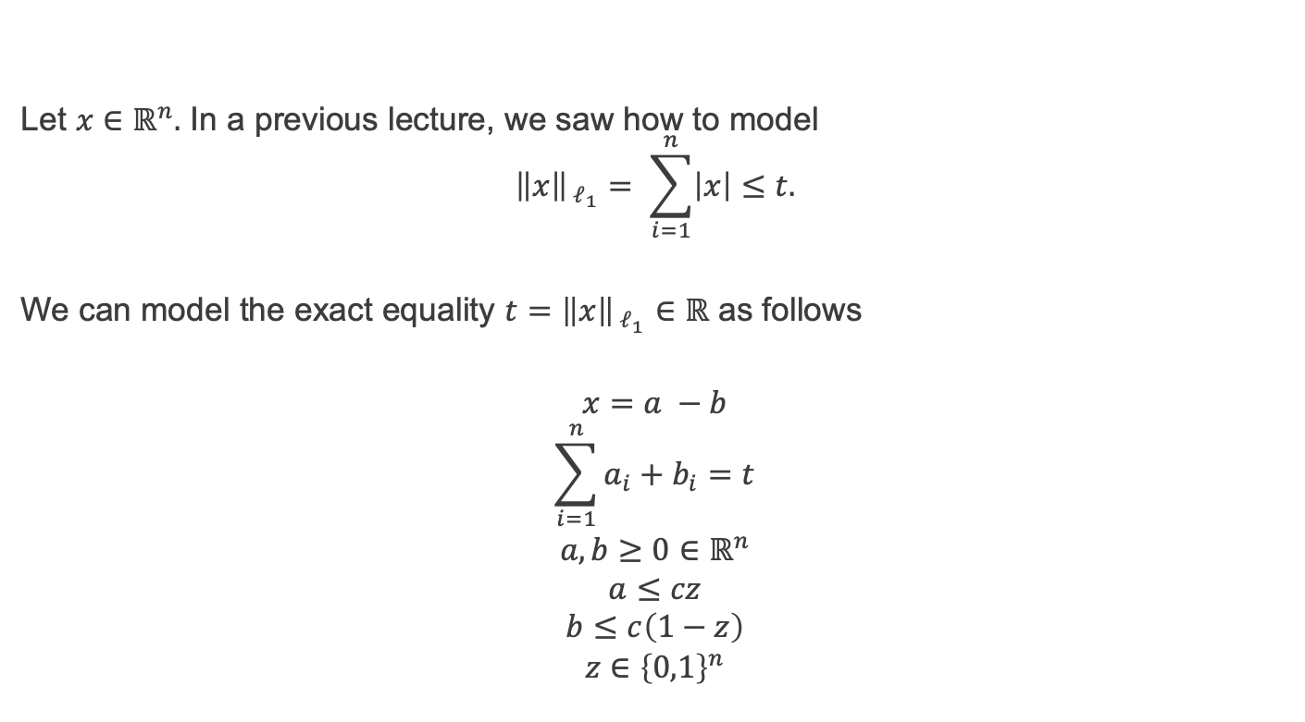
Exact $ℓ_{1}$-norm
Let $x∈ℝ^{n}.$ In a previous lecture, we saw how to model $${\left\|x\right\|}_{{ ℓ}_{1}}= \sum_{i=1}^{n}{\left|x\right|}≤t.$$
We can model the exact equality $t={\left\|x\right\|}_{{ ℓ}_{1}}∈ℝ$ as follows
$$\begin{matrix}x=a −b \\ \begin{aligned}\sum_{i=1}^{n}{a_{i}+b_{i}=t} \\ a,b≥0∈ℝ^{n} \\ a≤cz \\ b≤c\left(1−z\right)\end{aligned} \\ z∈{\left\{0,1\right\}}^{n}\end{matrix}$$

Slide 11
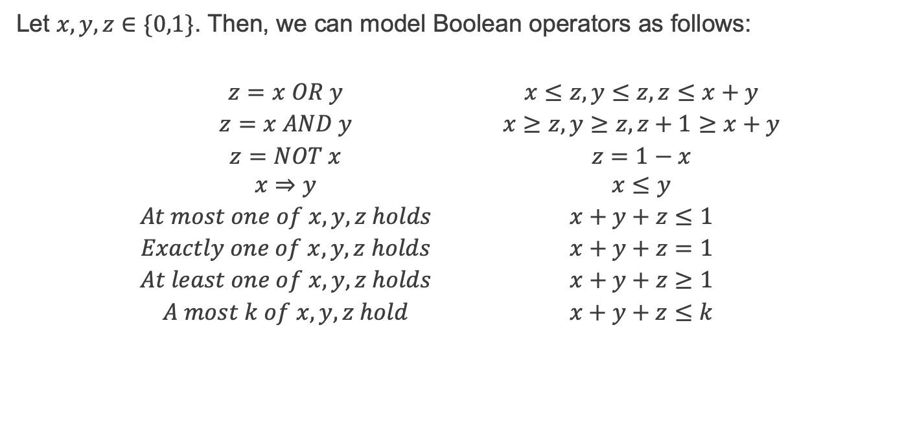
Boolean operators
Let $x,y,z∈\{0,1\}$. Then, we can model Boolean operators as follows:
$$\begin{matrix}z=x OR y & & x≤z, y≤z, z≤x+y \\ z=x AND y & & x≥z, y≥z, z+1≥x+y \\ z=NOT x & & z=1−x \\ x⇒y & & x≤y \\ At most one of x,y,z holds & & x+y+z≤1 \\ Exactly one of x,y,z holds & & x+y+z=1 \\ At least one of x,y,z holds & & x+y+z≥1 \\ A most k of x,y,z hold & & x+y+z≤k\end{matrix}$$

Slide 12

Bilinear equality
Let $x,y∈ℝ$. The bilinear constraint $xy=0$, which models the alternative
$$x=0 or y=0,$$
can be modelled as
$$\begin{matrix}\left|x\right|≤Mz \\ \left|y\right|≤M(1−z) \\ z∈\{0,1\}\end{matrix}$$
for a suitable constant $M$.

Slide 13
Summary and self-study
Summary: today we have learnt
how to model some nonlinear functions using mixed-integer linear programming.
Self-study: Consider the self-study exercise from OR Lecture 8_mixed_integer.pptx, but this time assume that I have collected 10 projects instead of 7. How should I modify the corresponding mixed-integer linear programming problem? Note that I cannot run all 10 projects because only I have only 32 students and each project should have at least 4 students.

